Slide 1
Speed Language Quizzes
Angular + Nest.js project

Slide 2

@StanimiraVlaeva
Google Developer Expert for Angular
Developer @VMWare Clarity
ex NativeScript Core team

Slide 3
Technologies

Slide 4
Frontend
Angular 10
Twitter Bootstrap
HTML5 + CSS3

Slide 5
Backend
Nest.js
MongoDB
JSON Web Tokens
Passport

Slide 6
Functionality

Slide 7
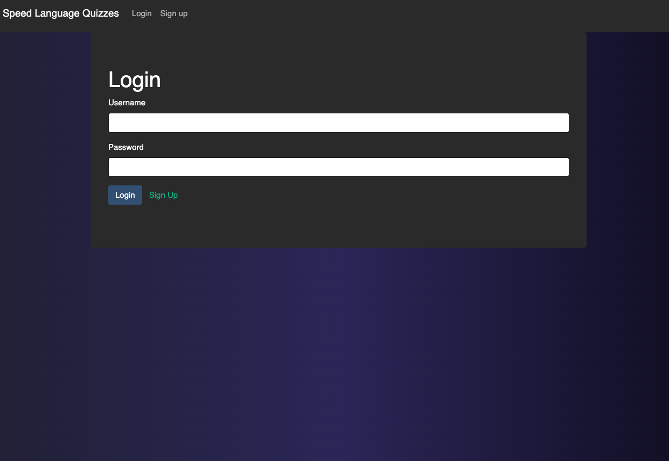
Login

Slide 8
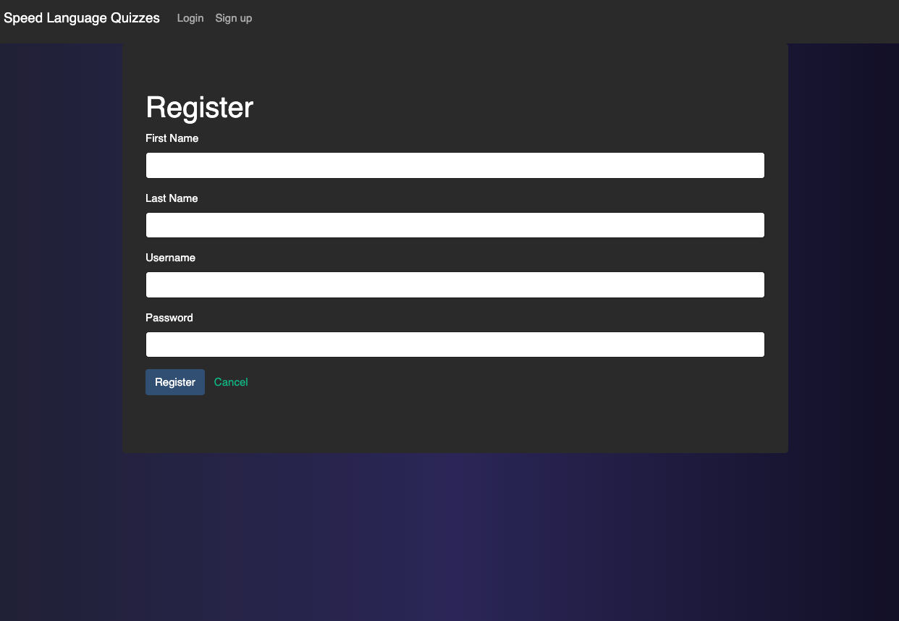
Registration

Slide 9
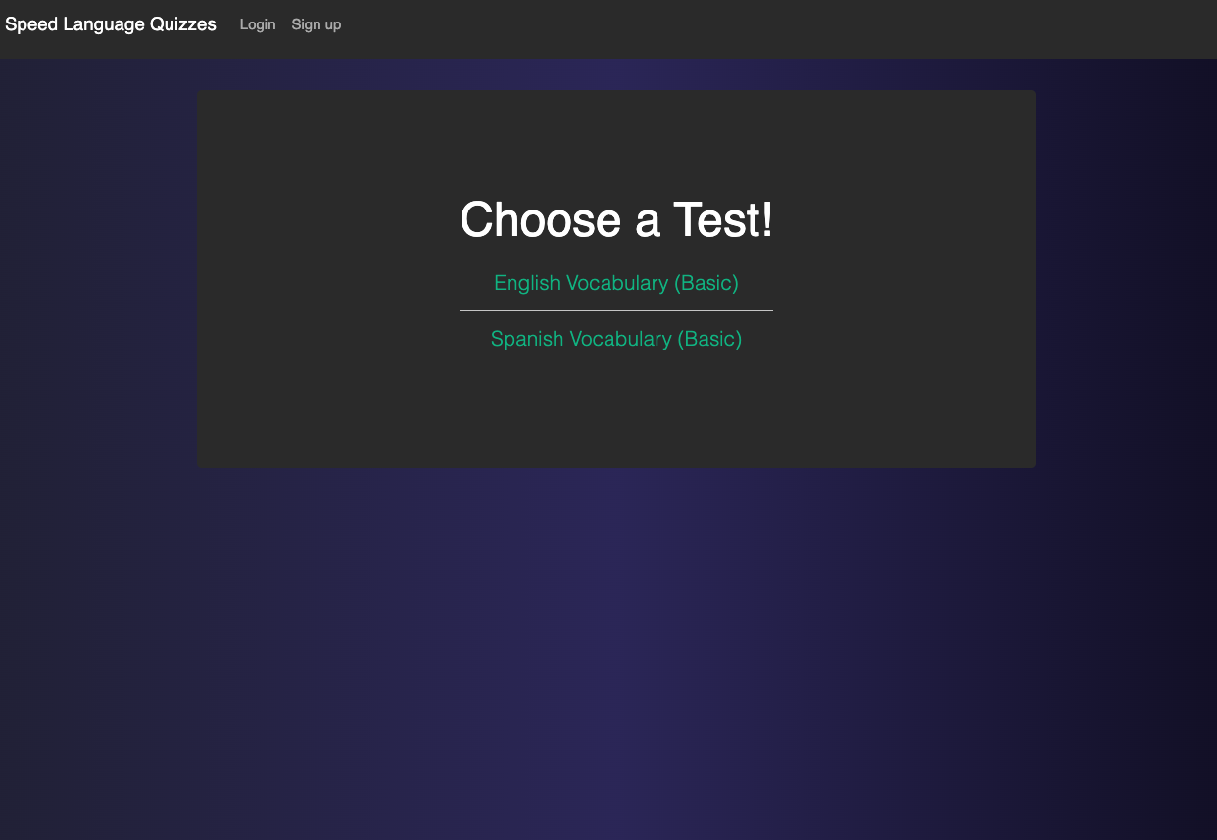
Tests List

Slide 10
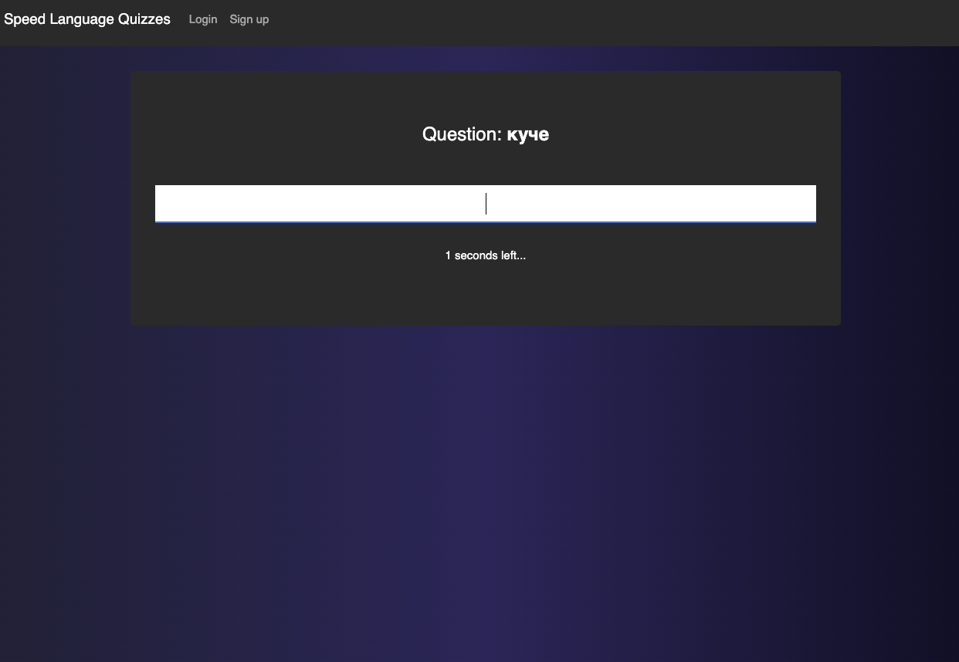
Doing a test

Slide 11
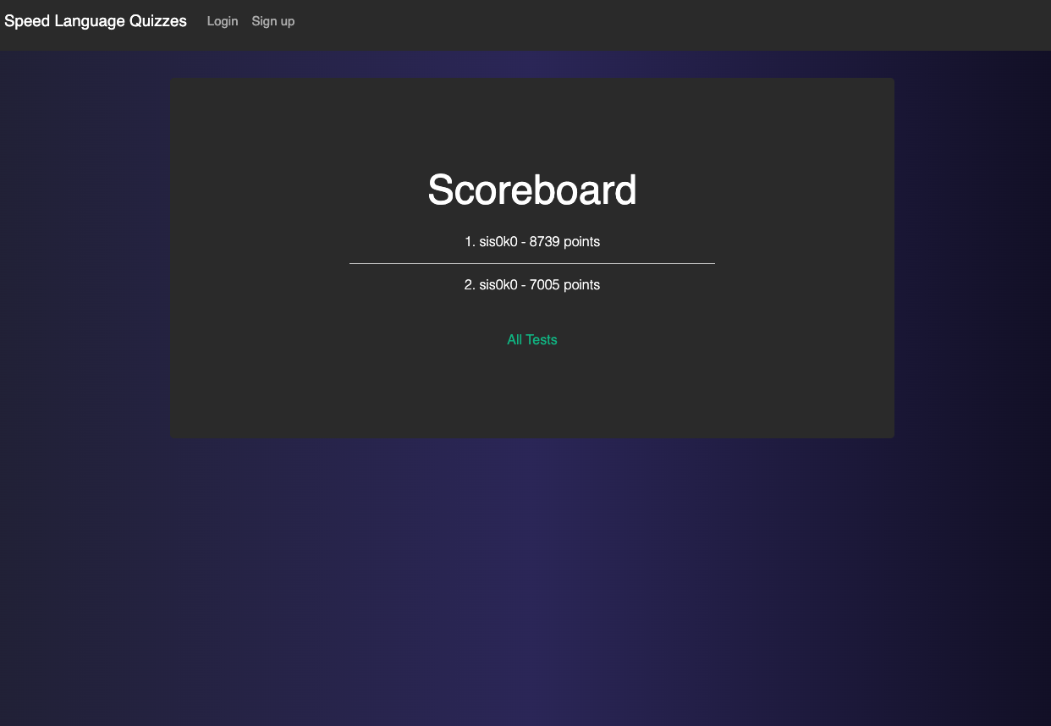
Scoreboard

